Slide 1
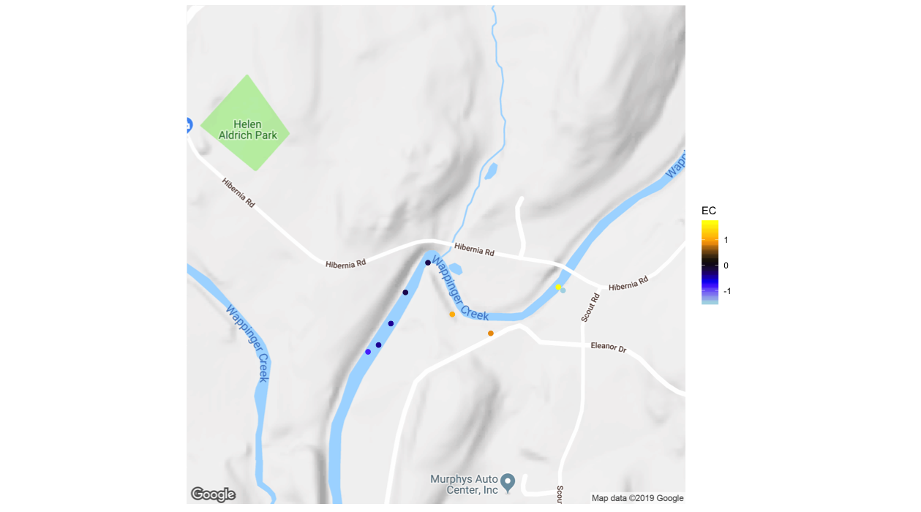
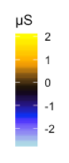
Reach Normalized Electrical Conductivity (μS)
Zone 1-2
High Angle
Fault Zone
Zone 1-1
Contrast A
0.5
0.5 Km

